Slide 1
An Evaluator’s Guide to Institutional
Recognition and Accreditation
Alexander Agafonov, Ph.D., Globe Language Services
Aleks Morawski, Foreign Credits
Mario Caruso, International Evaluation Services

Slide 2
Determining recognition of institutions outside the United States and comparing it to regional academic accreditation in the U.S. for undergraduate and graduate admissions purposes.

Slide 3
Association of International Credential Evaluators (AICE)
2018 AICE Symposium Report:
http://aice-eval.org/evaluation-guides/research
Setting the Standards for Evaluating Institutional Recognition and Accreditation

Slide 4
Regional vs. National vs. Specialized vs. Programmatic accreditation in the United States
Institutional accreditation in the United States:
Regional academic accreditation
Other types of accreditation in the United States
Unique nature of accreditation in the United States compared to foreign education systems.
Recognition in most countries around the world deals with the authority to conduct educational activities and grant degrees. Institutional recognition is the closest status to regional academic accreditation.

Slide 5
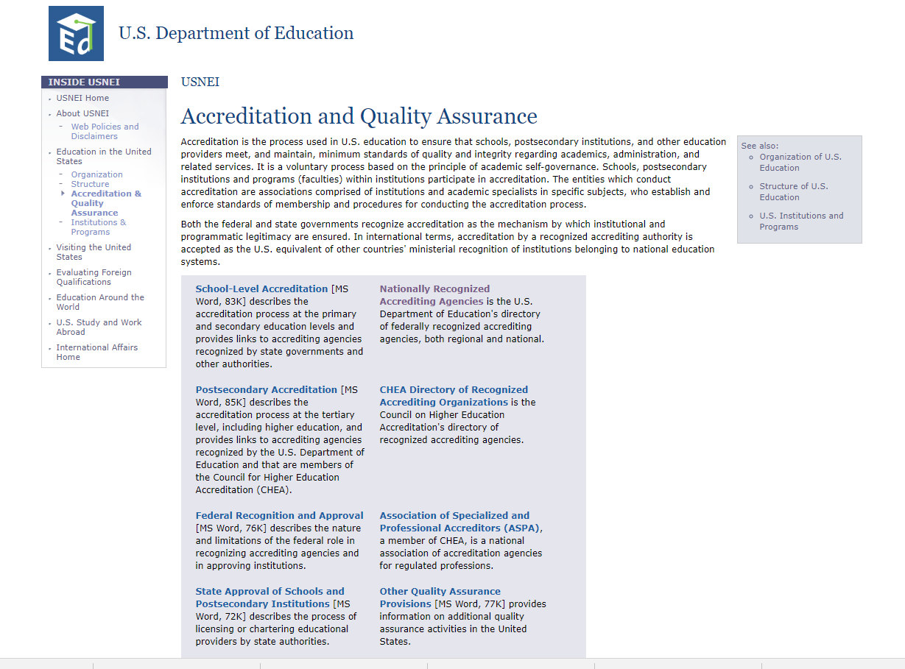
https://www2.ed.gov/about/offices/list/ous/international/usnei/us/edlite-accreditation.html

Slide 6
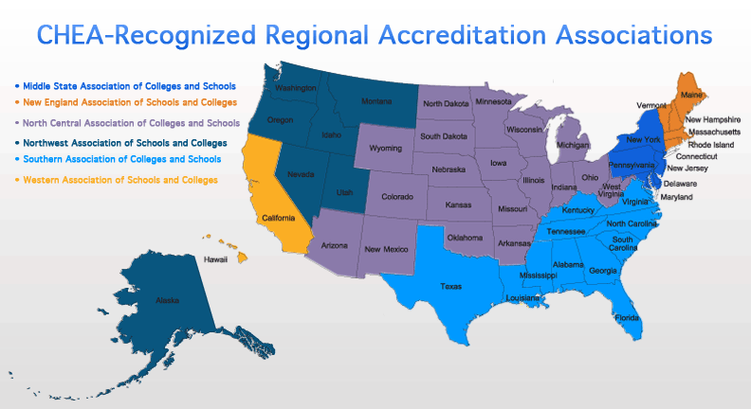
Regional vs. National vs. Specialized vs. Programmatic accreditation in the United States

Slide 7
AACRAO-AICE Survey 2018
Accreditation and Recognition of International Education
  AACRAO-AICE January 2018 “60-Second Survey”
  https://www.aacrao.org/docs/default-source/default-document-library/accreditation-and-recognition-of-international-education-nbsp---january-60-second-survey.pdf?sfvrsn=2da8f6f8_2
Results presented at the AICE Symposium, March, 2018 by Melanie Gottlieb, Deputy Director, AACRAO

Slide 8
RESPONDENTS
Control, Type and Size Count of Control
Public |  | 290
Lower Division Only | 88
Undergraduate | 21
Undergraduate, graduate and/or professional | 175
Graduate and/or professional | 4
Other | 2
Private, not-for-profit |  | 276
Lower Division Only | 4
Undergraduate | 57
Undergraduate, graduate and/or professional | 195
Graduate and/or professional | 19
Other | 1
Private, proprietary |  | 22
Lower Division Only | 1
Undergraduate | 6
Undergraduate, graduate and/or professional | 11
Graduate and/or professional | 3
Other | 1
Grand Total |  | 588
588 Respondents
  552 US institutions, 36 non-US (21 Canada)
  290 public institutions; 276 private non-profit, 22 proprietary

Slide 9
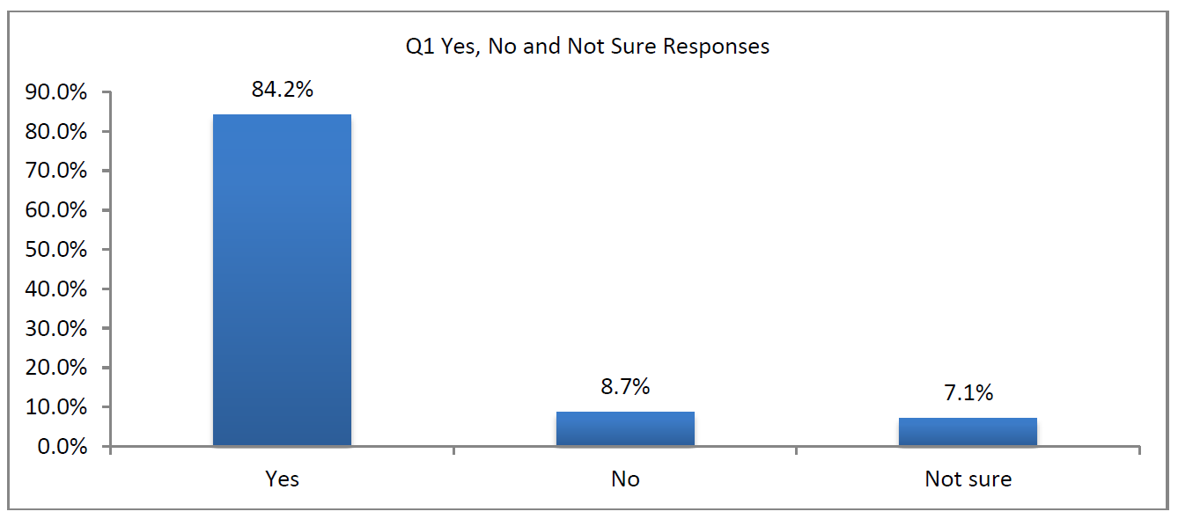
Does your institution have a prescribed policy on regional accreditation requirements for admission and transfer-of-credit purposes?
Comprehensive institutions are more likely than other types of institutions to have a prescribed policy

Slide 10
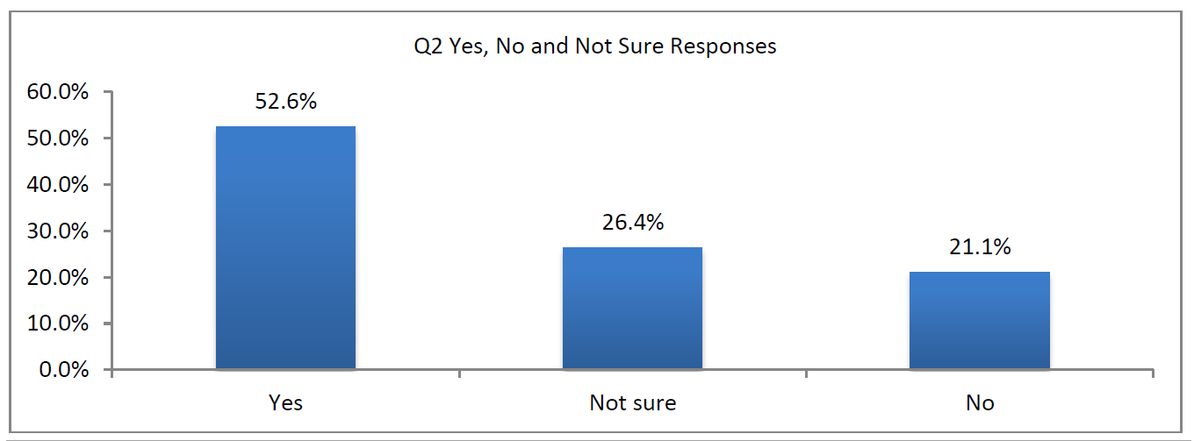
According to your institution's current practice/guidelines, would a foreign institution's recognition by a national ministry of education be equivalent to regional academic accreditation in the United States?

Slide 11
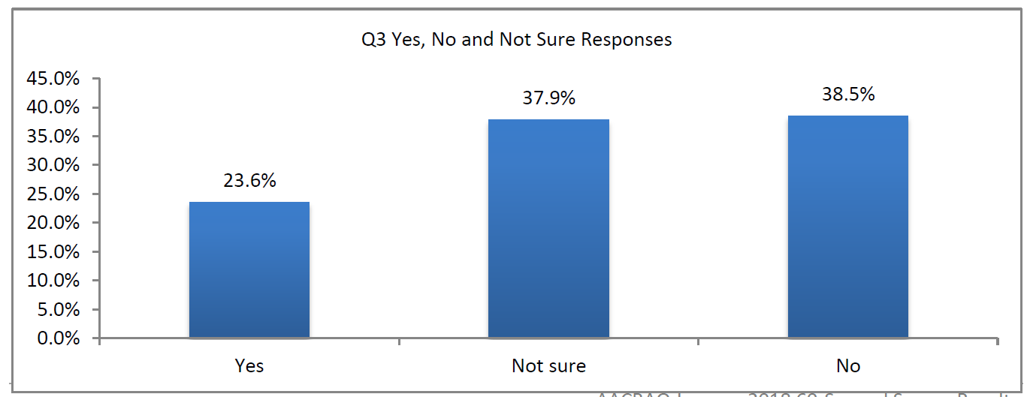
According to your institution's current practice/guidelines, would a foreign institution's recognition by a national government board or body overseeing professional training or employment be equivalent to regional academic accreditation in the United States?

Slide 12
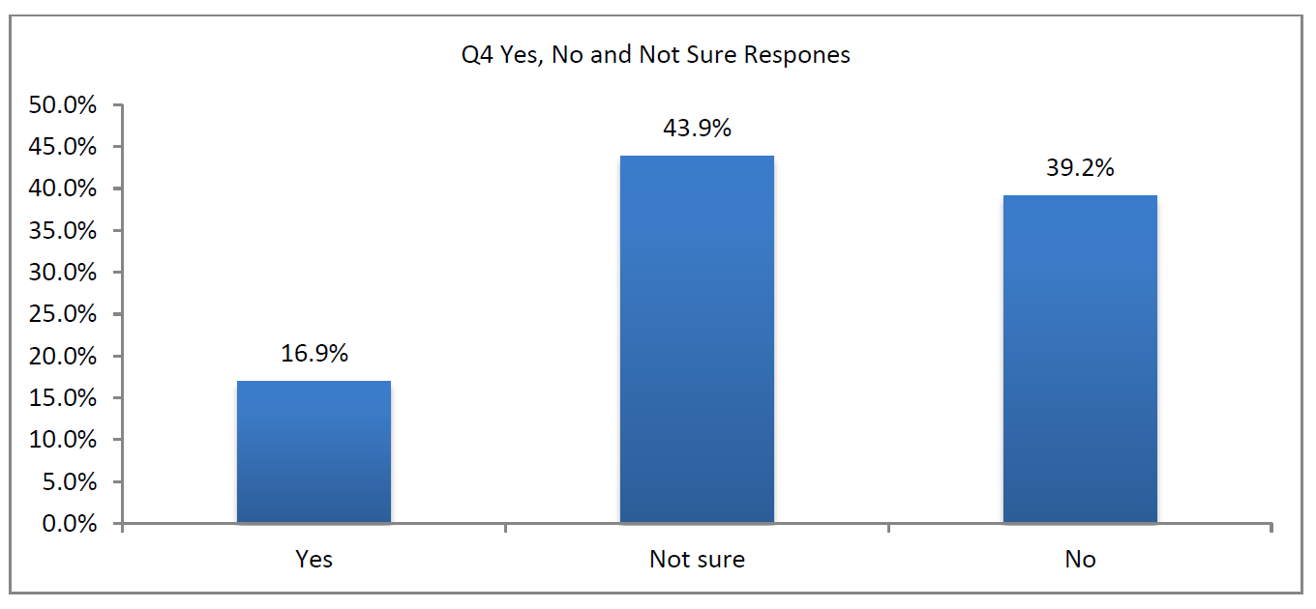
According to your institution's current practice/guidelines, would a foreign institution's recognition by a national government board or body overseeing specific professional sectors (Health/Agriculture/Defense/etc.) be equivalent to regional academic accreditation in the United States?

Slide 13
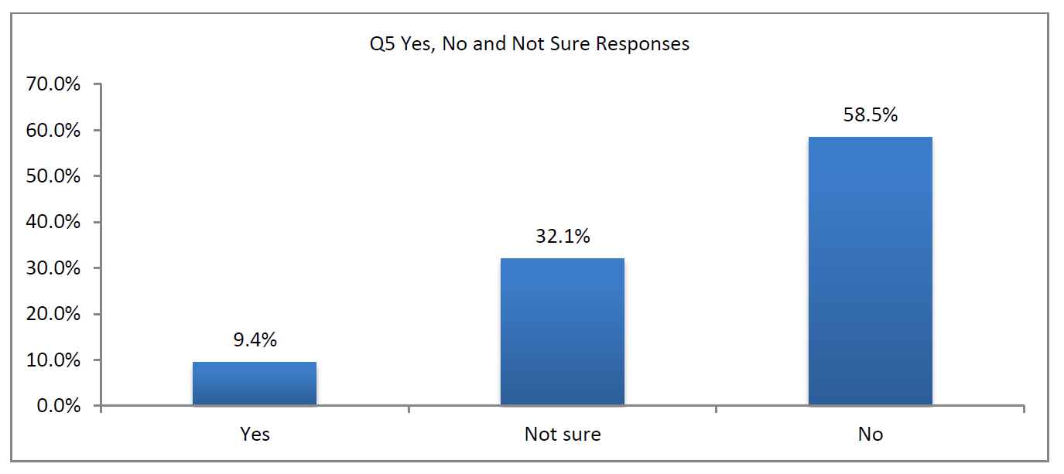
According to your institution's current practice/guidelines, would a foreign institution's recognition by a non-governmental organization, such as a private or corporate quality assurance or accreditation organization be equivalent to regional academic accreditation in the United States?

Slide 14
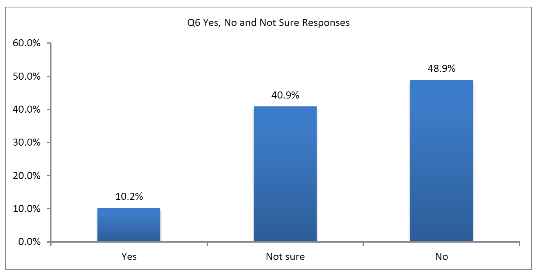
According to your institution's current practice/guidelines, would a foreign institution's recognition by a governmental board of a foreign government (outside of where the institution is geographically located) be equivalent to regional academic accreditation in the United States?

Slide 15
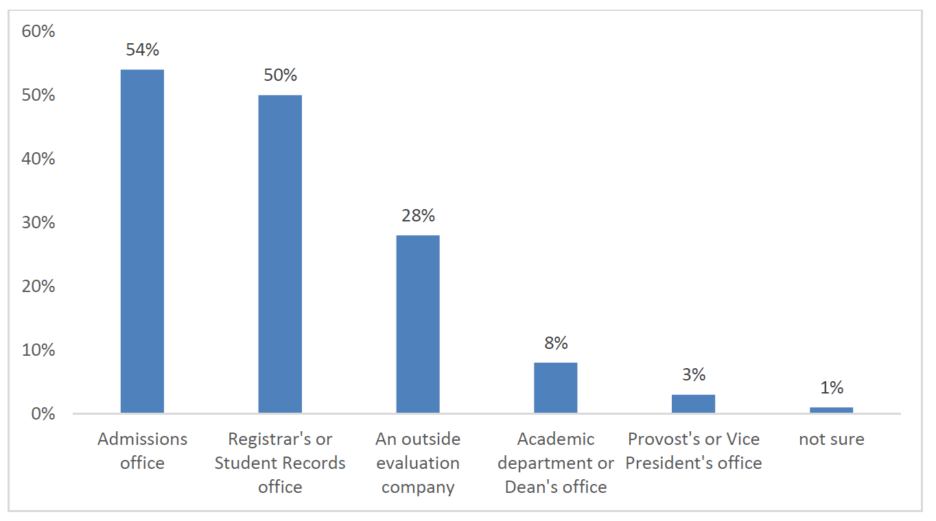
For admission purposes, which office at your institution is responsible for determining whether students' foreign education comes from an accredited school?
Recognition issues are nearly equally decided by the admissions office and the registrar’s office for the purposes of admission

Slide 16
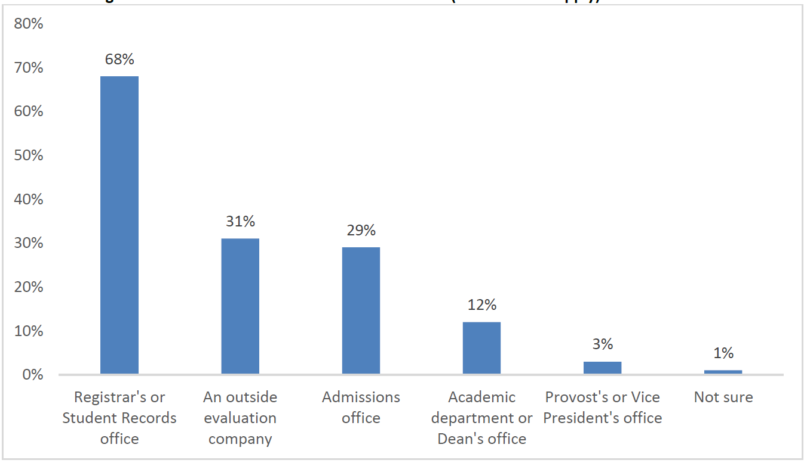
For transfer-of-credit purposes, which office at your institution is responsible for determining whether students' foreign education comes from an accredited school?
The registrar’s office is the primary decider on recognition for the purposes of transfer credit

Slide 17
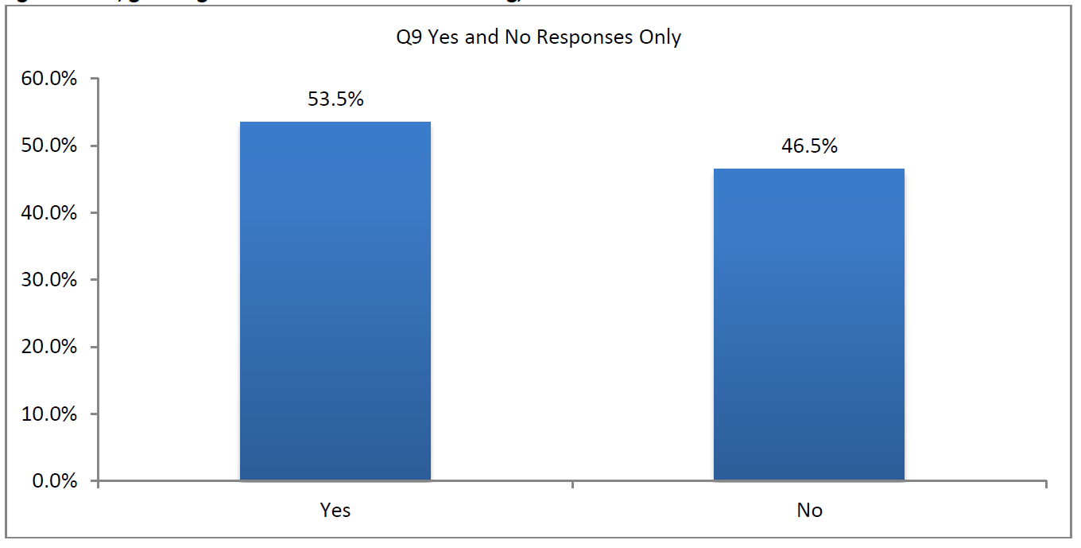
Are you aware of any exceptions to regional accreditation requirements for admission or transfer-of-credit purposes which your institution makes?
More than half of responding institutions have exceptions to regional accreditation requirements for admission or transfer of credit.

Slide 18
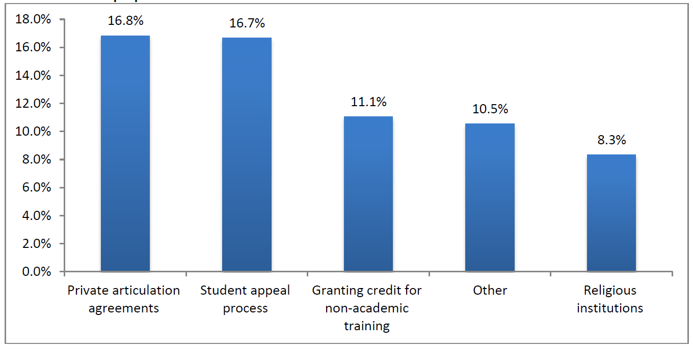
What are the known exceptions to regional accreditation requirements for admission of transfer-of-credit purposes?

Slide 19
What are the known exceptions to regional accreditation requirements for admission of transfer-of-credit purposes?
For admissions purposes, but not transfer credit
For approved study abroad credit
Case-by-case approval process
  Faculty department review of course materials and instructor credentials
  Applicable to major
  Previously approved by another regionally accredited institution
Prior learning assessments
National Accreditation
DOE approval

Slide 20
ADDITIONAL THOUGHTS & Questions
  There is an identified gap in institutional understanding of recognition practices outside of the US once you move beyond the Ministry of Education
  There appears to be some reliance on outside evaluation services to support institutional decision-making
    How are evaluation services framing the recognition statement?

Slide 21
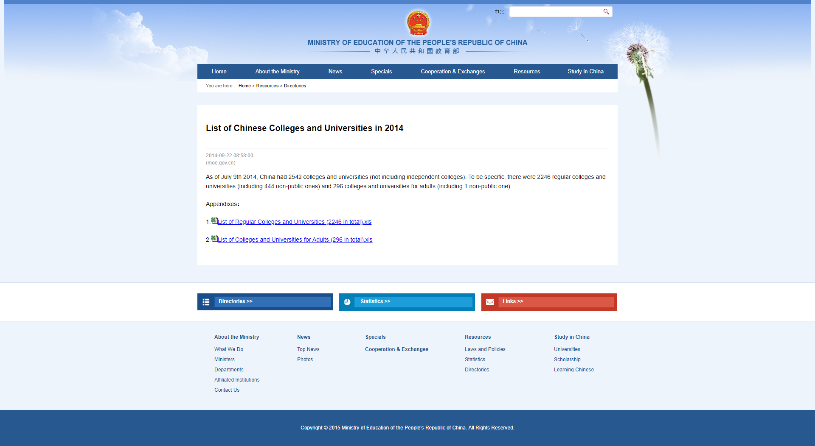
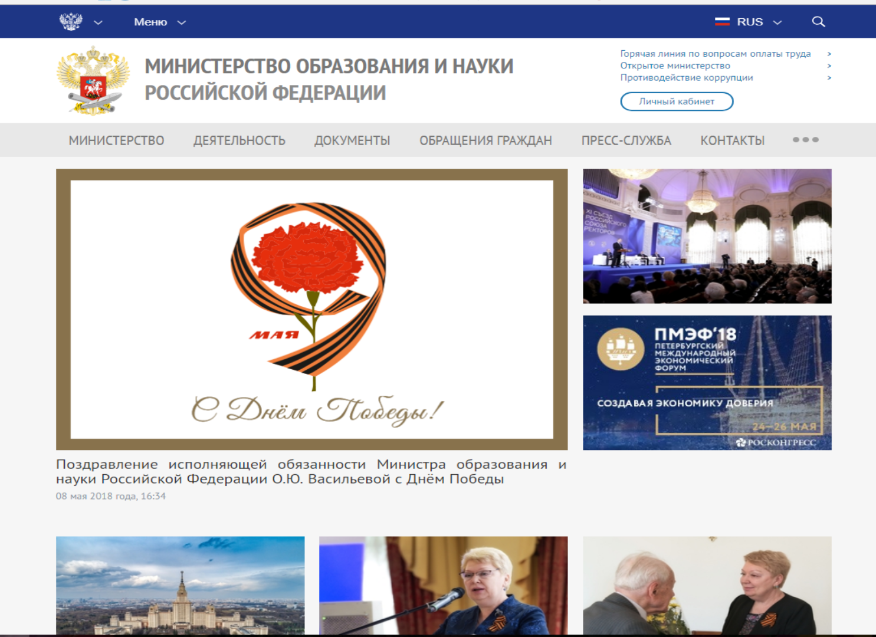
Popular resources for determining recognition status/ accreditation of foreign institutions
In-country Resources:
Ministries of Education
  National or Regional
  Comprehensive
  Level-specific (General, Higher, Etc)
Professional Ministries
  Health, Agriculture, Defense, Technical, Etc.
Examination Boards
  Primarily Secondary, but not always
“Other” governmental bodies overseeing education

Slide 22
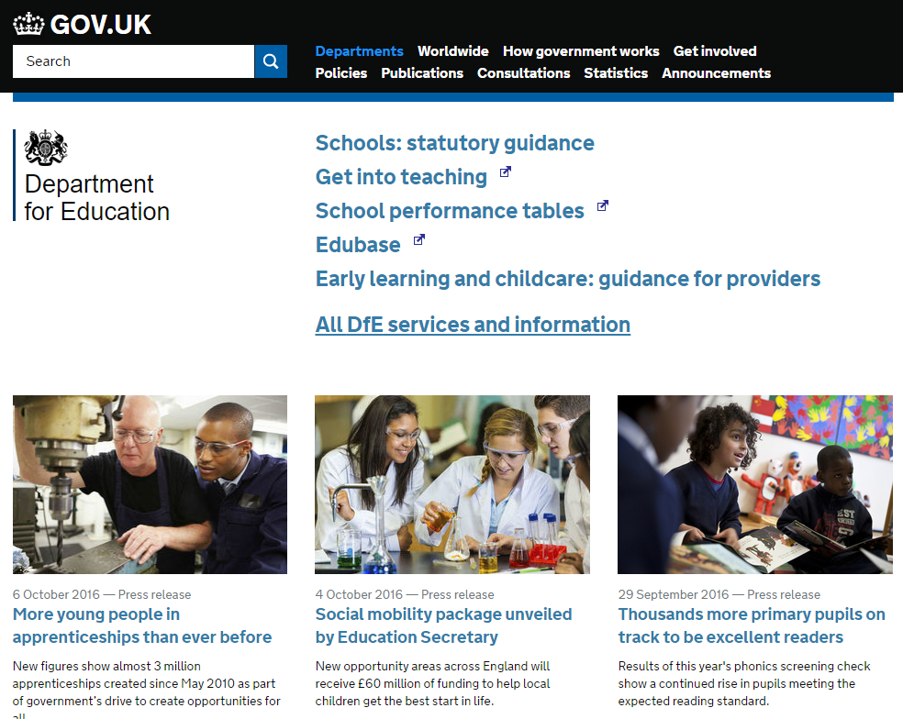
Government organizations (ministries) offer primary source information
http://www.education.gov.uk/

Slide 23
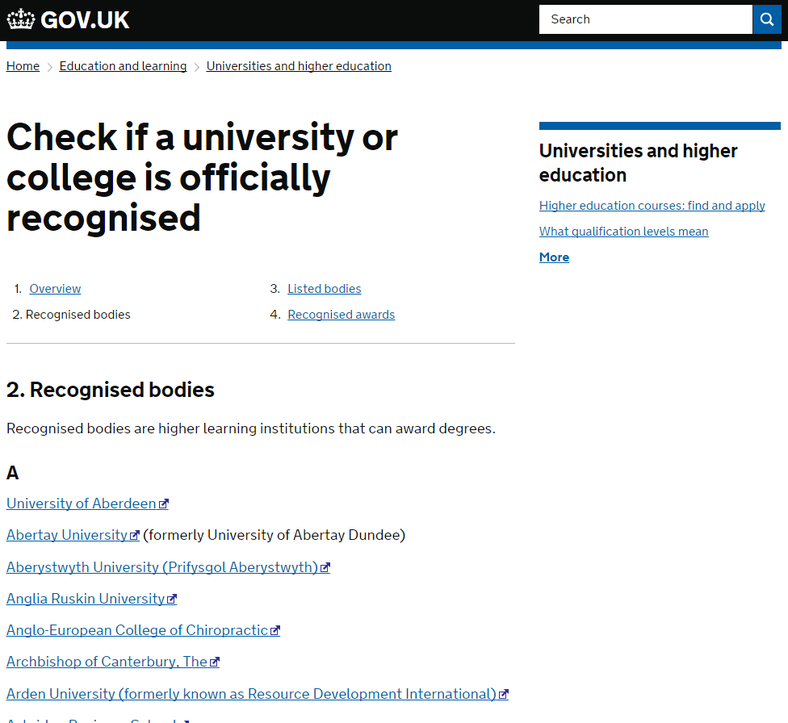
Many Ministries often have a page to verify recognition - this is the first place to look when investigating an institution's accreditation /recognition
https://www.gov.uk/check-a-university-is-officially-recognised/recognised-bodies

Slide 24
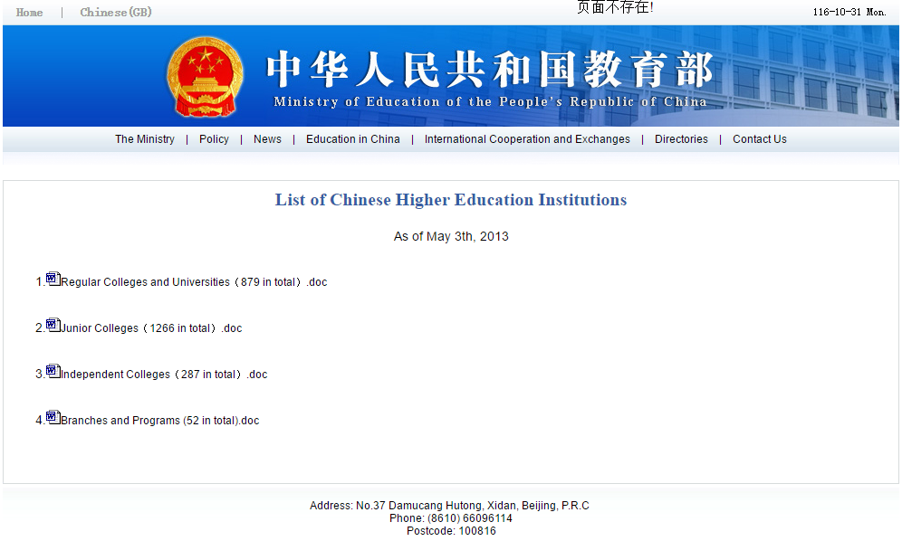
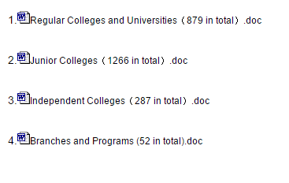

http://www.moe.edu.cn/publicfiles/business/htmlfiles/moe/moe_2812/200906/48836.html

Slide 25
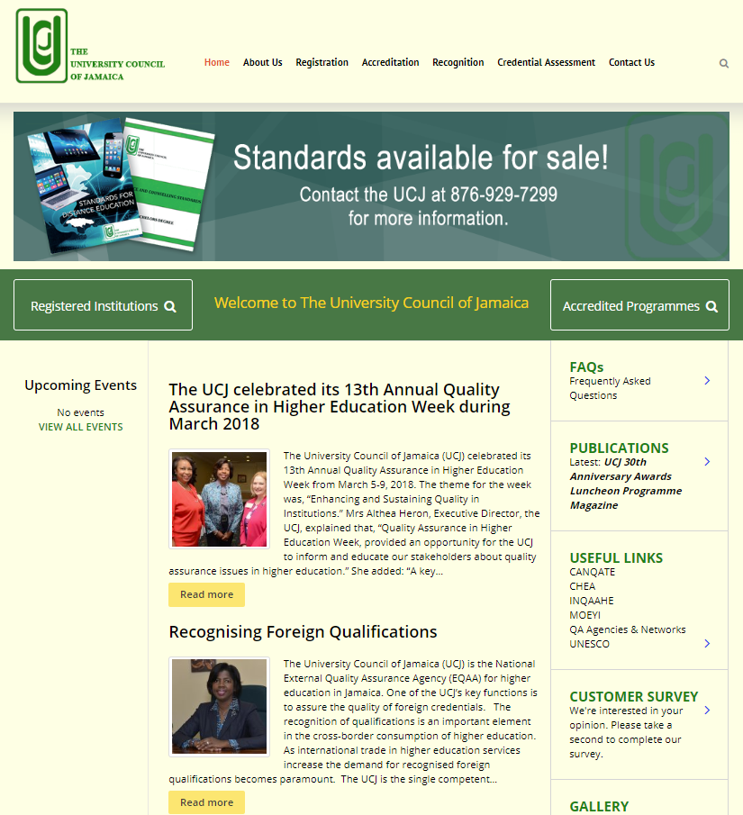
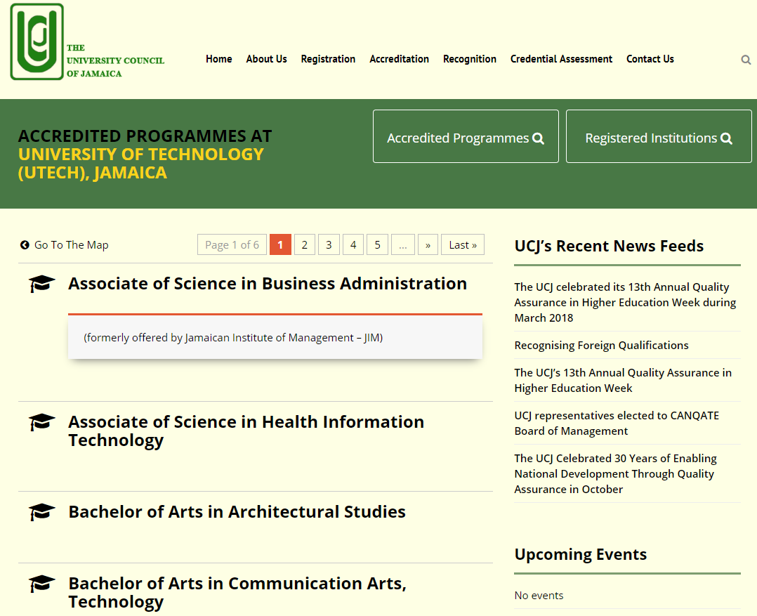
Programmatic Accreditation
http://www.ucj.org.jm/

Slide 26
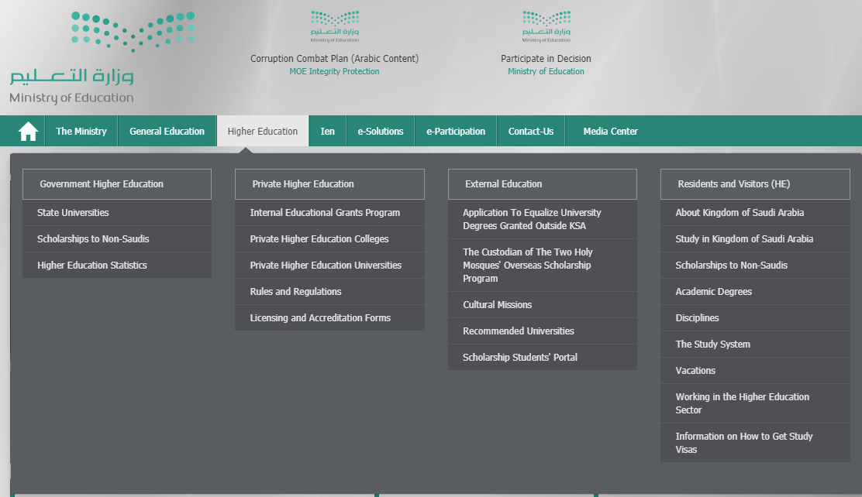
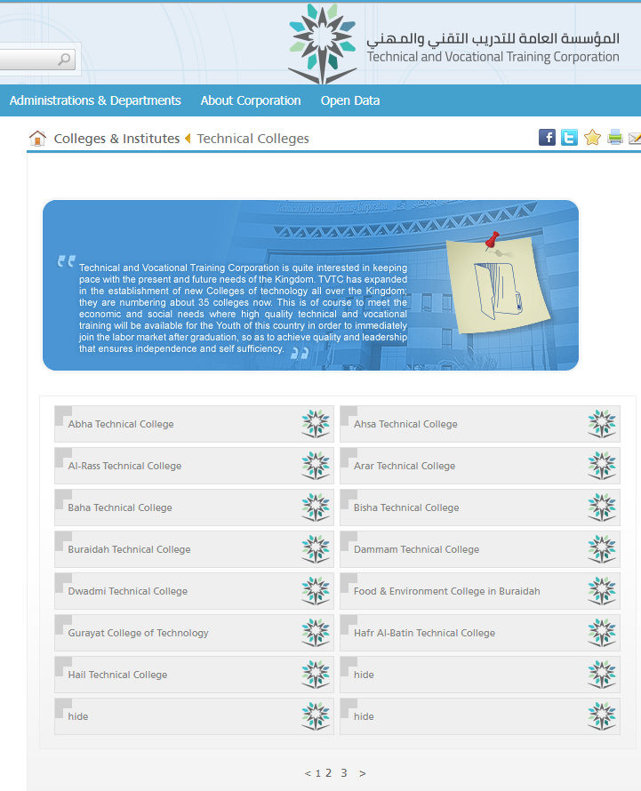
Non-MOE sources of institutional recognition:
Saudi Arabia – Ministry of Education vs. Technical and Vocational Training Corporation
www.tvtc.gov.sa
www.moe.gov.sa

Slide 27
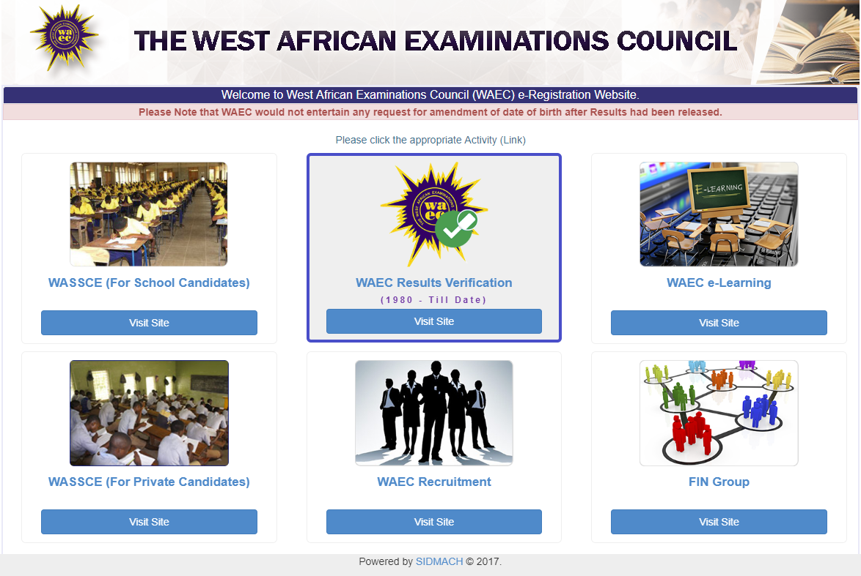
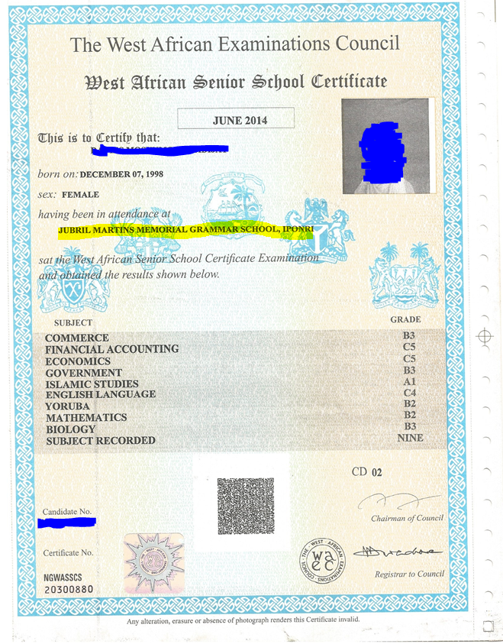
Examination Boards – West African Examinations Council
Hint: Common in British-patterned education systems!
http://www.waeconline.org.ng

Slide 28
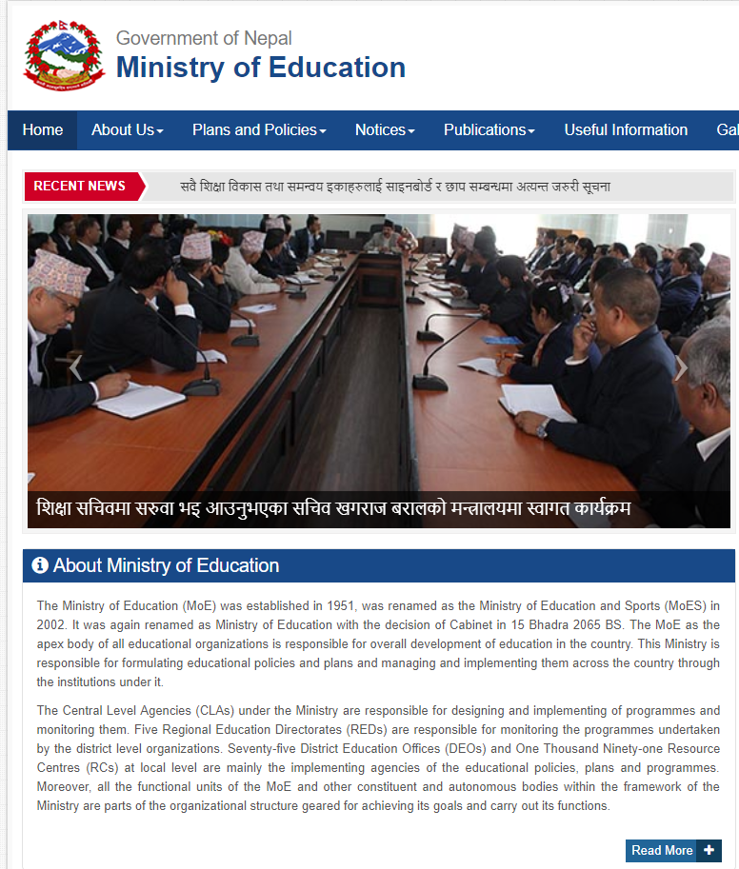
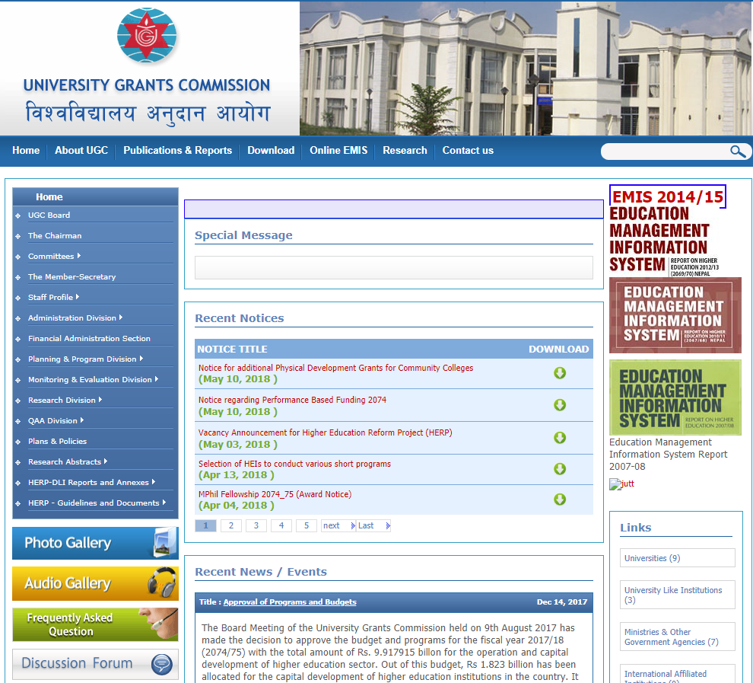
“Other” governmental entities overseeing education
http://moe.gov.np
http://www.ugcnepal.edu.np
“The University Grants Commission (UGC) was established after the implementation of multiuniversity concept in Nepal. The UGC Act was approved by the Parliament on BS 2050 Mangsir 7, and it came into functioning during BS 2051. UGC is responsible for allocation and disbursement of grants to the universities and their campuses, regulating their activities and formulating policies and programs on establishment of new universities.”

Slide 29
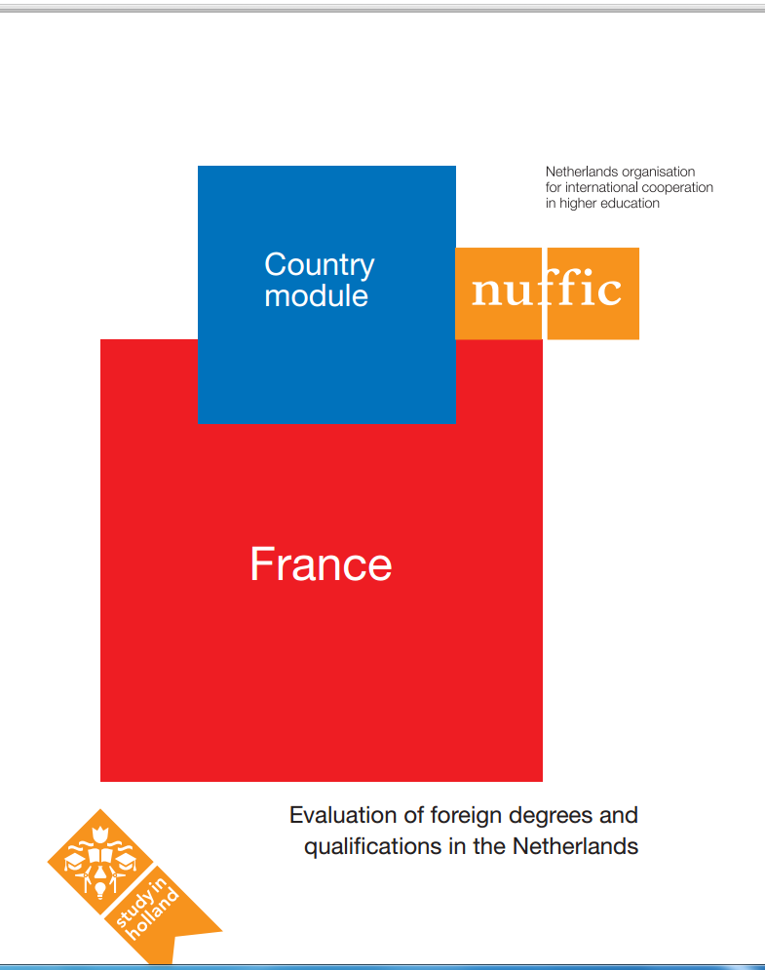
Popular resources for determining recognition status/ accreditation of foreign institutions
Multi-national Resources from
Non-governmental Sources:
NAFSA online guides www.nafsa.org
AACRAO EDGE edge.aacrao.org
NUFFIC country modules www.nuffic.nl
ENIC-NARIC www.enic-naric.net

Slide 30
Popular resources for determining recognition status/ accreditation of foreign institutions
Other Useful Resources:
Researching International Education Systems and Institutions – Peggy Bell Hedrickson, 2008
    http://www.nafsa.org/uploadedFiles/NAFSA_Home/Resource_Library_Assets/ACE/researching_internationalization.pdf?n=3838
Government Sites/Ministries of Education, March 2012
    https://www.nafsa.org/_/File/_/govt_sites_foreign_ed.pdf
See the attached list
Researching accreditation status of secondary, post-secondary, and unaccredited institutions.

Slide 31


Challenges from Various Countries/ Regions
India
  UGC (University Grants Commission)
  AICTE (All India Council for Technical Education )

Slide 32
India – UGC vs AICTE
University Grants Commission:
Established through an Act of Parliament in 1956
Purpose: Coordination, determination and maintenance of standards of university education in India
“The University Grants Commission (UGC) came into existence on 28th December, 1953 and became a statutory Organization of the Government of India by an Act of Parliament in 1956, for the coordination, determination and maintenance of standards of teaching, examination and research in university education.” (https://www.ugc.ac.in/)
*Allocates funding and oversees teaching and research standards
Quality control mechanism = NAAC (National Assessment and Accreditation Council (voluntary participation)

Slide 33

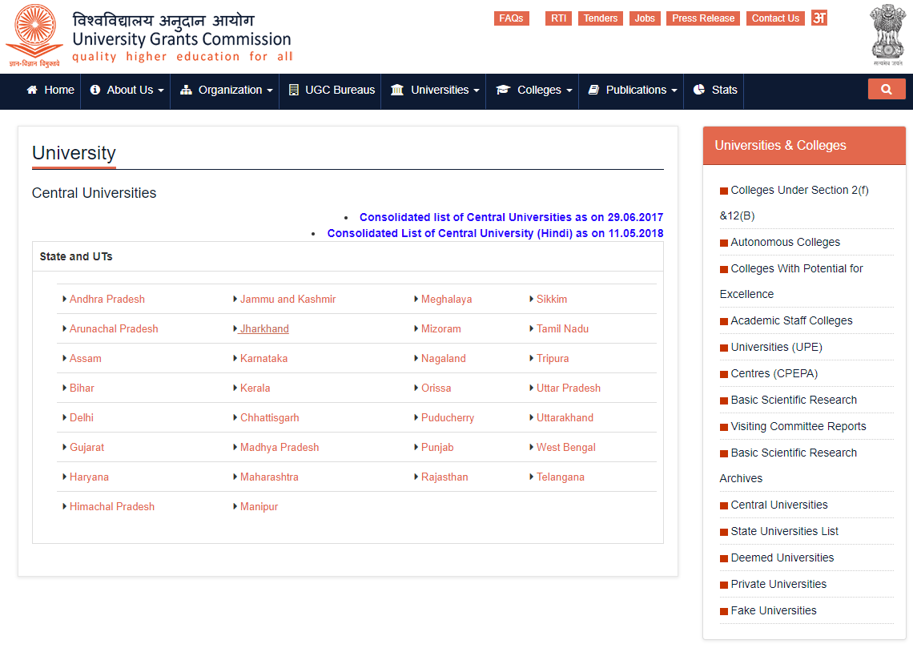
https://www.ugc.ac.in/
Central Universities
State Universities
Deemed Universities
State Private Universities
Fake Universities

Slide 34
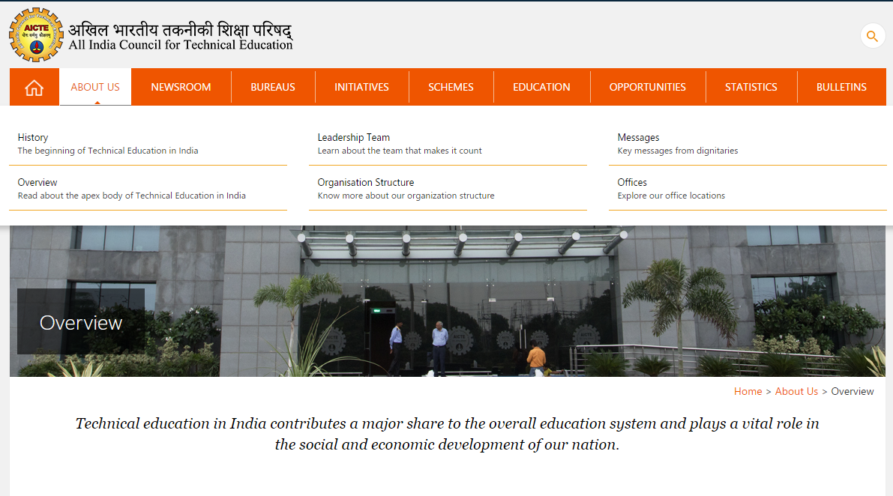
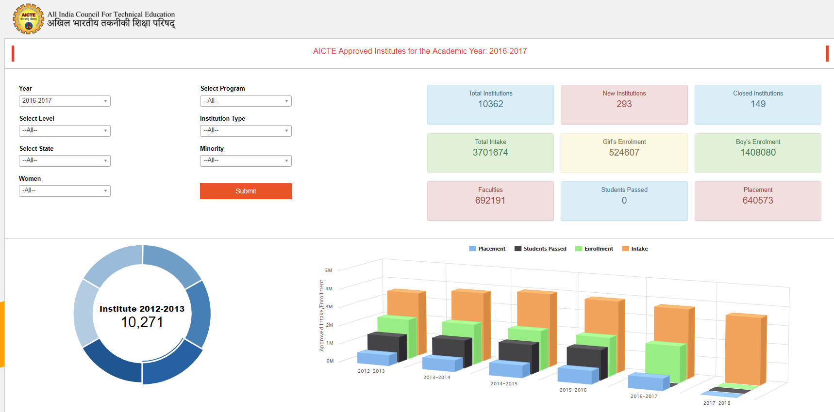
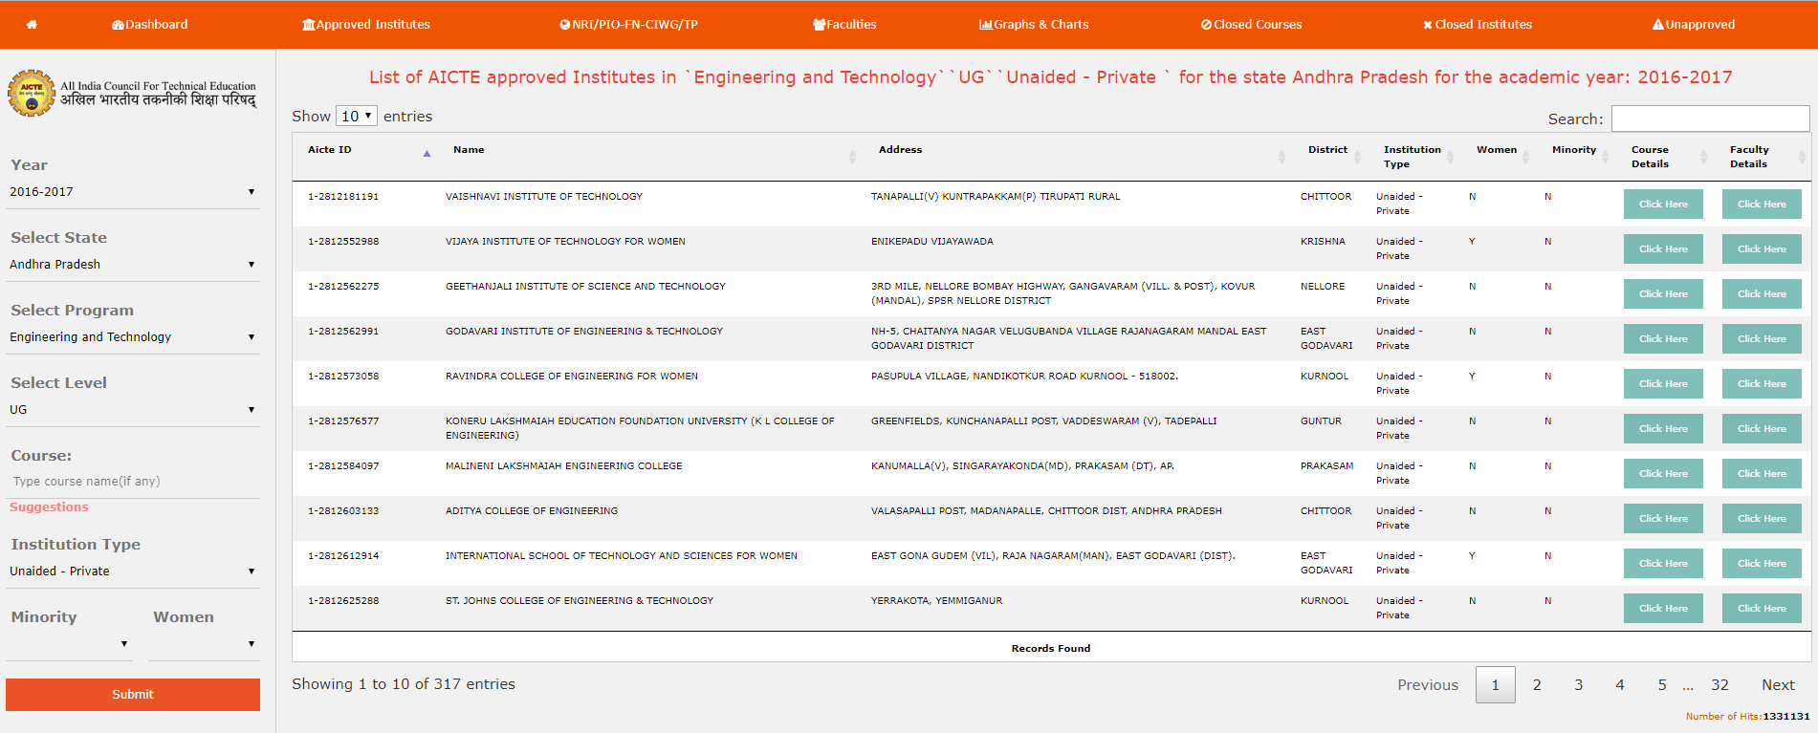
https://www.aicte-india.org
Approved Institutes
Faculties
Institutes w/NBA-approved courses
Unapproved institutes
Closed courses/institutes
Institutes with autonomy

Slide 35
India – UGC vs. AICTE
All India Council for Technical Education
AICTE originated from the Ministry of Human Resource Development
Objectives: Promotion of quality in technical education; Planning and coordinated development of technical education system; Regulation and maintenance of norms and standards
Vision: “To be a world-class organization leading technological and socio-economic development of the country by enhancing the global competitiveness of technical manpower and by ensuring high quality technical education to all sections of the society.” (https://www.aicte-india.org/about-us/overview)
Offers Diploma, undergraduate and postgraduate level programs
Quality Control Mechanism = National Board of Accreditation (NBA) – Programmatic and voluntary

Slide 36
Overlapping recognition causes confusion and calls for reform in India.
2017 proposal to replace UGC and ICTE with one entity
  Past proposals were launched without success
Questions to ask:
  Is this eligible for further education in India?
  What do my peer institutions do?
  Is the applicant qualified to succeed in the program applied to?
  Others?
 | UGC | AICTE
National Recognition | Yes | Yes
Academic Credentials (Bachelor, Master, Doctorate) | Yes | Yes
Other Credentials (Certificate, Diploma, Postgraduate Diploma) | No* | Yes
Inter-organizational Mobility | Yes | Academic Credentials – Yes
 |  | Professional Credentials – No*

Slide 37
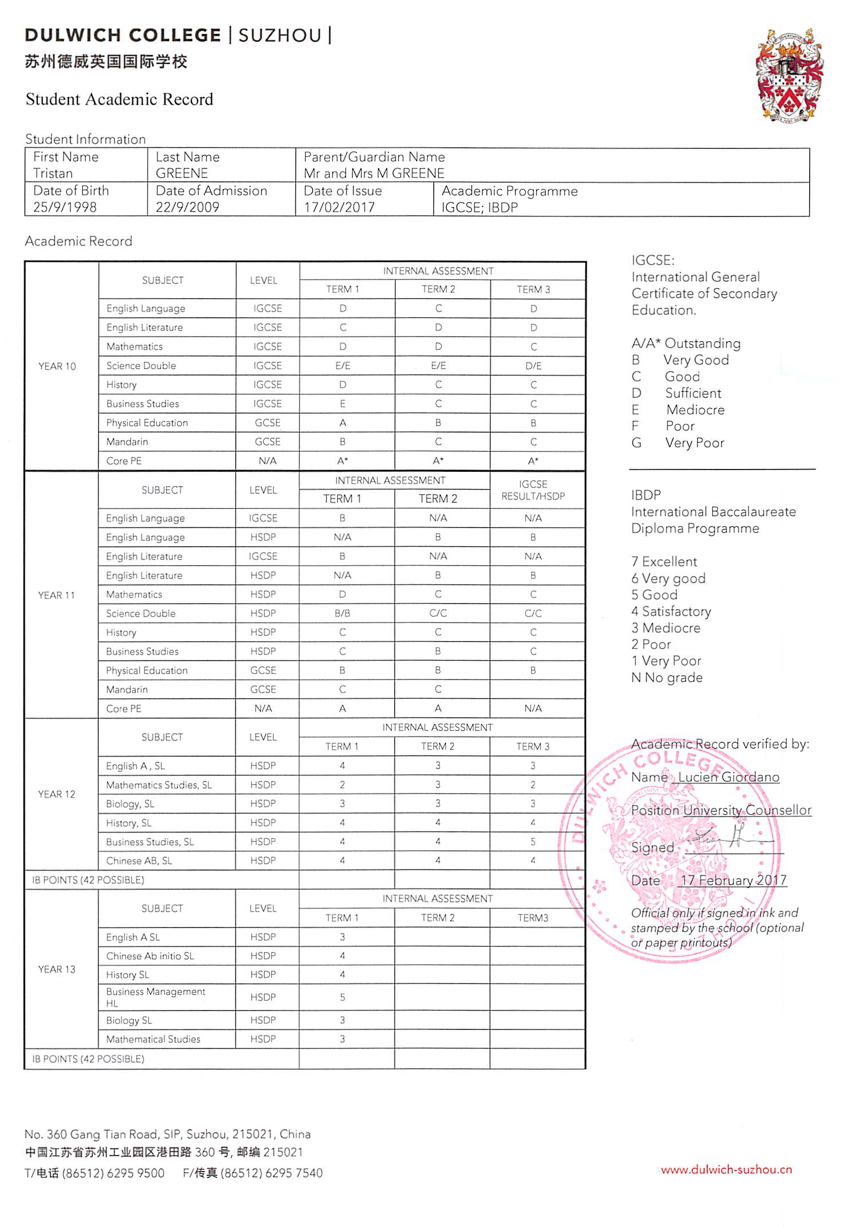
Challenges from Various Countries/ Regions
Secondary Schools in China

Slide 38
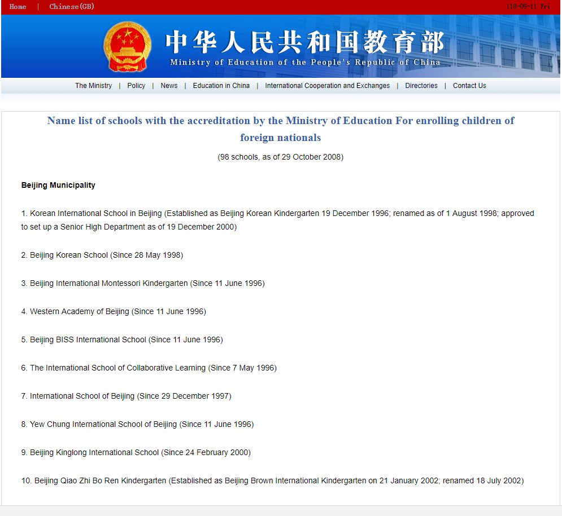

Slide 39
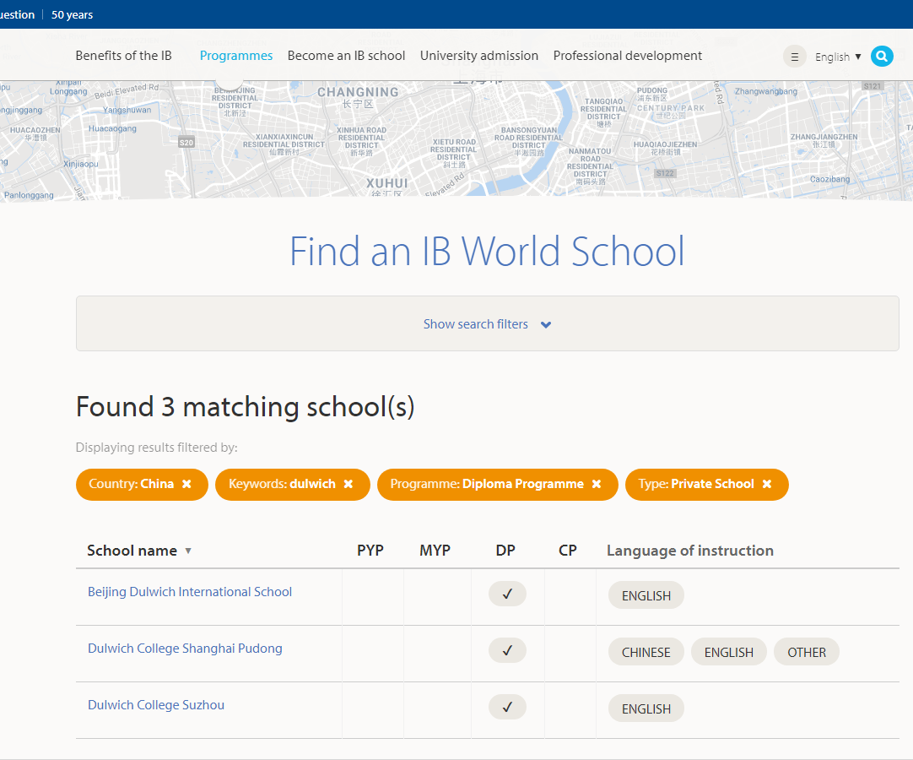

Slide 41
Diploma Mills and challenges with inauthentic institutional recognition
Accreditation Mill
  Often established by a diploma mill or other for-profit organization
  Falsely represents oversight of alleged academic institutions
  Falsely represents authority to monitor educational institution in a region/profession/level
  May operate at all education levels
Diploma Mill
  “Sells” credentials to individuals to represent ‘earned’ credentials with little effort
  Falsely represents quality education and institutional esteem
  Falsely represents quality control mechanisms
  Makes statements about being immune to accreditation or quality control

Slide 42
Recognizing Diploma and Accreditation Mills
Lack of recognition by governmental authorities overseeing education
Lack of membership by known and legitimately-recognized institutions
Poorly documented method of institutional investigation or certification process
Evidence of affiliation with known/confirmed diploma mills
Promise of academic degree primarily for life experience or independent work
Tuition and fee structure mentioned early and prominently
Lack of physical address or physical address appears dubious
Explicit claims of accreditation and recognition by oversight bodies other than the main ministry or regional accreditor

Slide 43

It’s not just the credential evaluator’s problem
2015 New York Times investigation – AXACT Corp in Pakistan employed over 2,000 people, and operated at least 370 diploma/accreditation mill websites
2016 – Charges dismissed in Pakistani court for “lack of prosecutable evidence”
January 2017 Pakistani court re-opens investigation
February 2018 Pakistan’s supreme court ordered high courts to render verdicts to fraud cases pending for almost three years
RESEARCH, DOCUMENT, ASK, SHARE. Institutional recognition affects you, your institution, and your students
https://www.nytimes.com/2015/05/18/world/asia/fake-diplomas-real-cash-pakistani-company-axact-reaps-millions-columbiana-barkley.html?_r=2
http://www.bbc.com/news/world-asia-32910734
http://www.universityworldnews.com/article.php?story=20180119200749642
http://www.universityworldnews.com/article.php?story=20180212140927240

Slide 44
Admission and transfer-of-credit requirements pertaining to institutional recognition.
“The educational quality of the sending institution is the primary consideration. Receiving institutions must ensure that decisions are based on a fair assessment of the institution’s educational quality and may include the regional, specialized and national accredited status of an institution, along with other factors as appropriate. …
There is assurance that the institution from which a student desires to transfer credit is a legitimate institution accredited by a U.S. Department of Education recognized accrediting body or that the institution, if in another country, is approved by the legitimate accreditation or quality assurance agencies that operate in that country.”
Accrediting Commission for Community and Junior Colleges (WASC)

Slide 45
Admission and transfer-of-credit requirements pertaining to institutional recognition.
Recognition in most countries around the world deals with the authority to conduct educational activities and grant degrees which is comparable to regional accreditation in the United States.
Recognition/Accreditation by a multi-national organization or membership in a multi-national group or religious denomination does not replace official, degree-granting authority by the government of the country.
Recognition of secondary level of education can be done either at the school level or by national examinations. In countries where a national examination framework exists, it generally take precedence over the recognition of an individual school.
In some cases, recognition of an institution might not be sufficient. Programmatic or specialized accreditation might be required for full accreditation comparability. In some countries, the government oversight bodies can offer both institutional and programmatic recognition.

Slide 46

Please complete this session evaluation
NOW!
      Or FAVORITE now
      and EVALUATE later!

Slide 47



Questions & Answers
Alexander Agafonov, Ph.D., President, Globe Language Services
alexander@globelanguage.com
Aleks Morawski, Director of Evaluation Services, Foreign Credits
amorawski@foreigncredits.com
Mario Caruso, President, International Evaluation Services
info@iesedu.org
Download this presentation free at:
www.globelanguage.com/presentations
www.foreigncredits.com/Resources/Presentations/
Thank You!

